Slide 1
Back End Engineering-II Project
Student E-Learning Platform
TEAM DETAILS:
SHIWANGI (TEAM LEADER) 2310992210(G-25) shiwangi2210.be23@chitkara.edu.in
RAMANJOT KAUR 2310992189 (G-25) ramanjot2189.be23@chitkara.edu.in
VANSHIKA 2310990912 (G-25) vanshika0912.be23@chitkara.edu.in
SHEFALI 2310992208 (G-25) shefali2208.be23@chitkara.edu.in
TEESHA 2310991069 (G-25) teesha1069.be23@chitkara.edu.in
Supervised By Batch-2023; G-25; Semester - V
Internal Faculty: Dr. Muskaan Chawla Project Id: 2
External Faculty: Mr. Shubham
:
Chitkara University Institute of Engineering and Technology,
Chitkara University, Punjab

Slide 2
Table of Contents
Introduction
Technical Details
Code Snippets
Output
Project Github Link

Slide 3
Introduction
The Edemy E-Learning Platform is a backend-driven web application designed to manage online courses, users, and administrative operations through efficient APIs and server-side rendering.
It provides RESTful APIs for creating, reading, updating, and deleting user and course data, enabling seamless integration with any frontend interface.
Built using Node.js, Express.js, MongoDB (Atlas), and Mongoose, the system ensures scalable data handling and secure storage.
The project also includes an Admin Dashboard built with EJS templating, offering statistics, user insights, and course management features.
Middleware is incorporated for authentication, validation, and request logging, ensuring system reliability and maintainability.
This backend system serves as the core engine of an e-learning platform, supporting modular expansion and future scalability.

Slide 4
Technical Details
Frontend:
React.js: Component-based UI with Hooks & Context
React Router: Client-side navigation (Home, About, Courses, CourseDetail)
Tailwind CSS: Responsive, utility-first styling
Backend:
Node.js: Scalable JavaScript runtime
Express.js: Routing, middleware, REST APIs
EJS: Server-side rendering for Admin Dashboard
MongoDB (Atlas): Cloud NoSQL database
Mongoose: Schema definitions & database management
bcryptjs: Secure password hashing
CORS: Cross-origin API communication

Slide 5
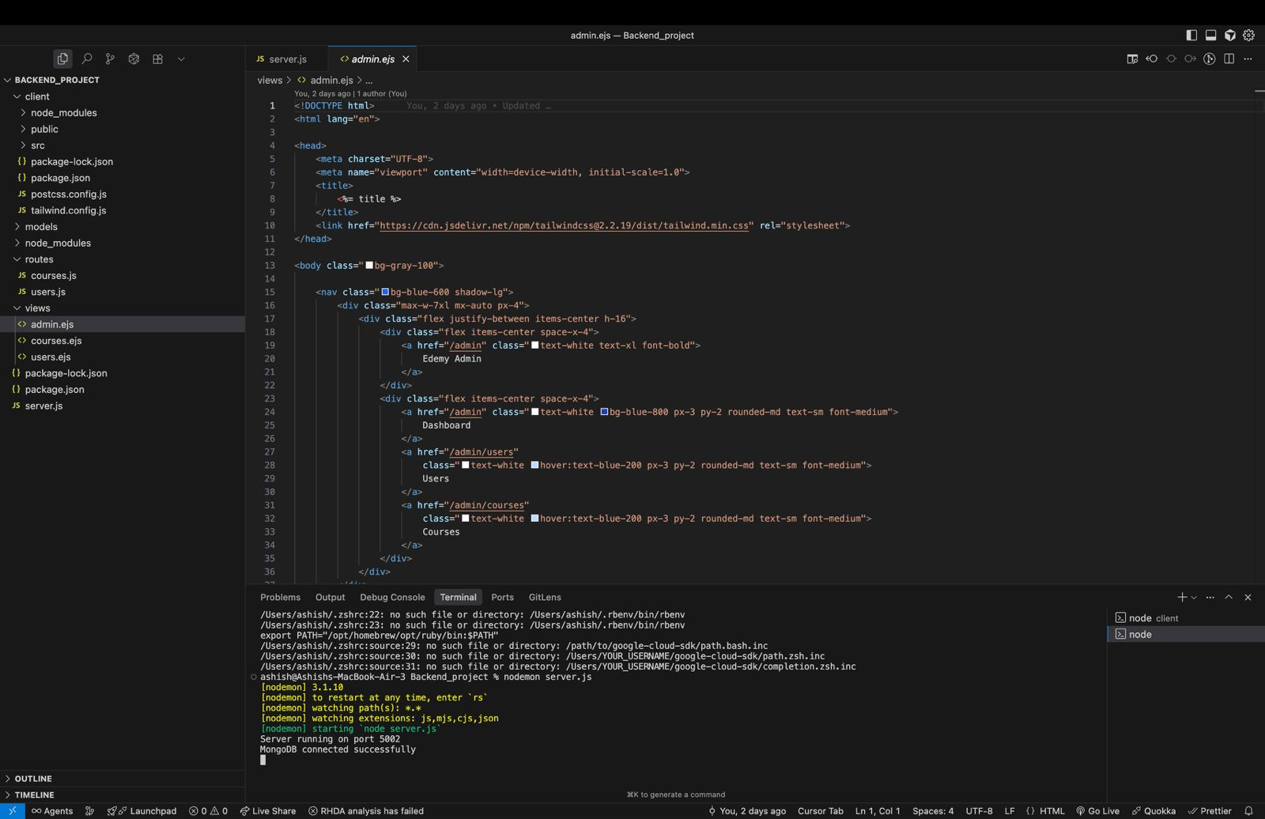
Code Snippets
Figure 1: admin.ejs

Slide 6
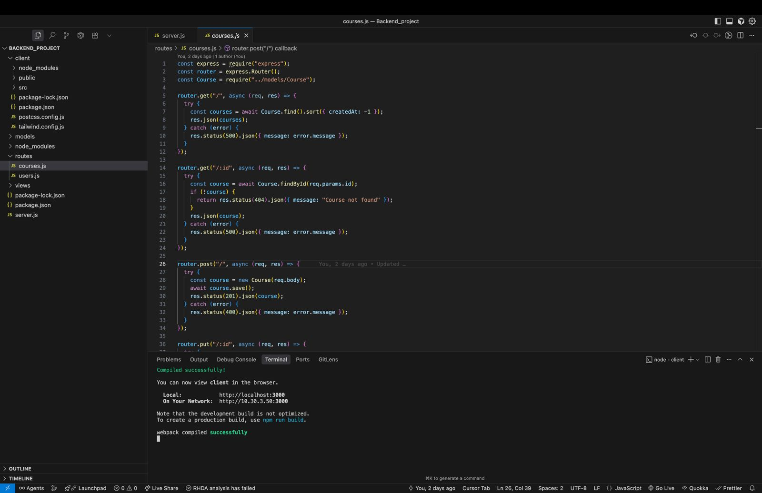
Code Snippets
Figure 2: Post.js

Slide 7

Output
Figure 3: Courses page

Slide 8
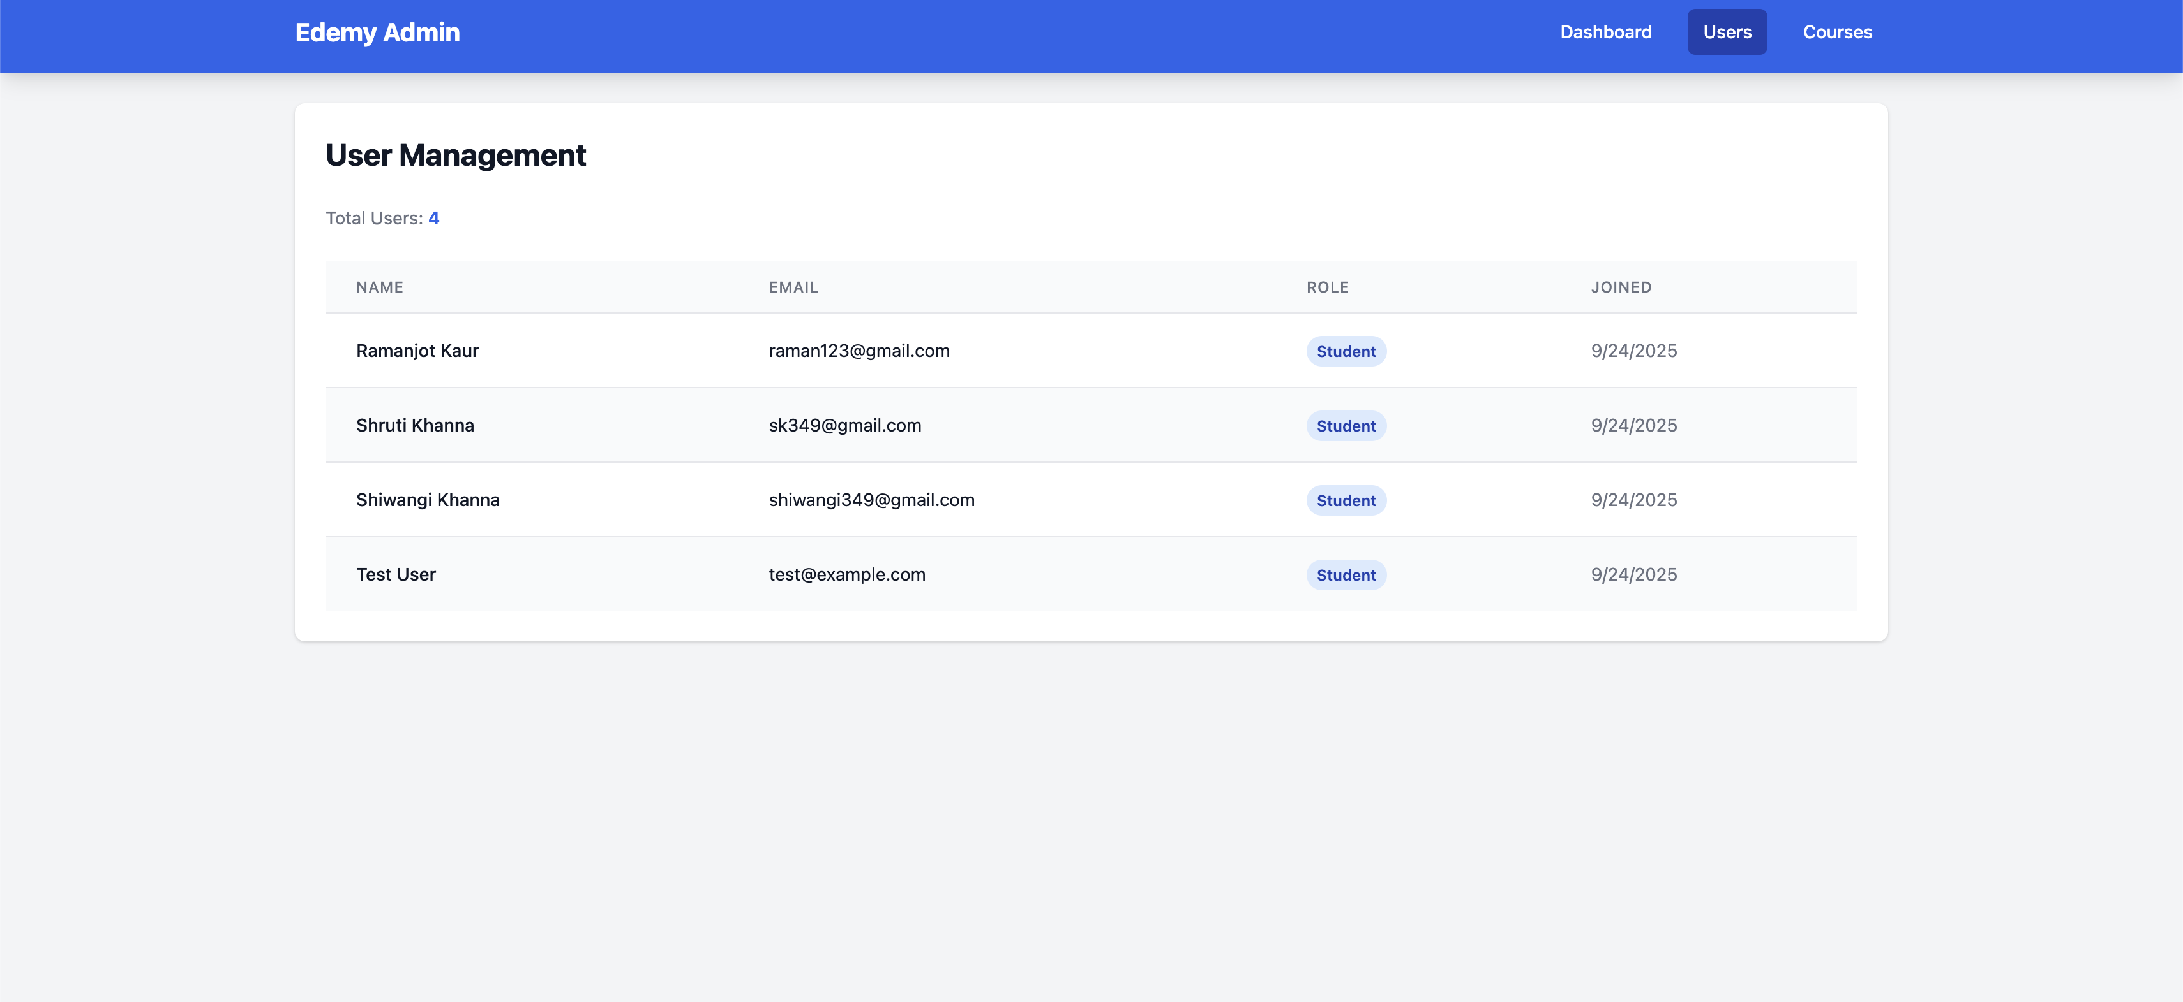
Output
Figure 4: User Management

Slide 9
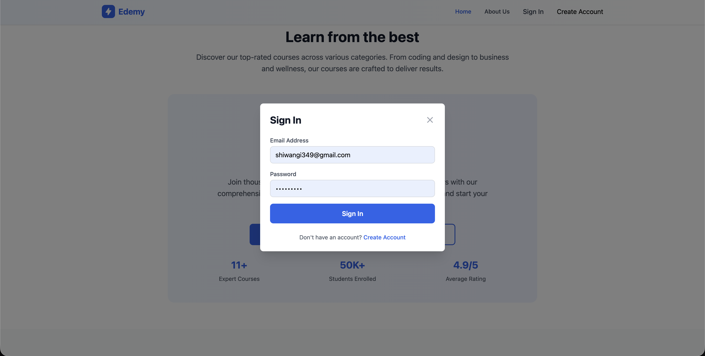
Output
Figure 5: SignIn Page

Slide 10

Output
Figure 6: Home Page

Slide 11
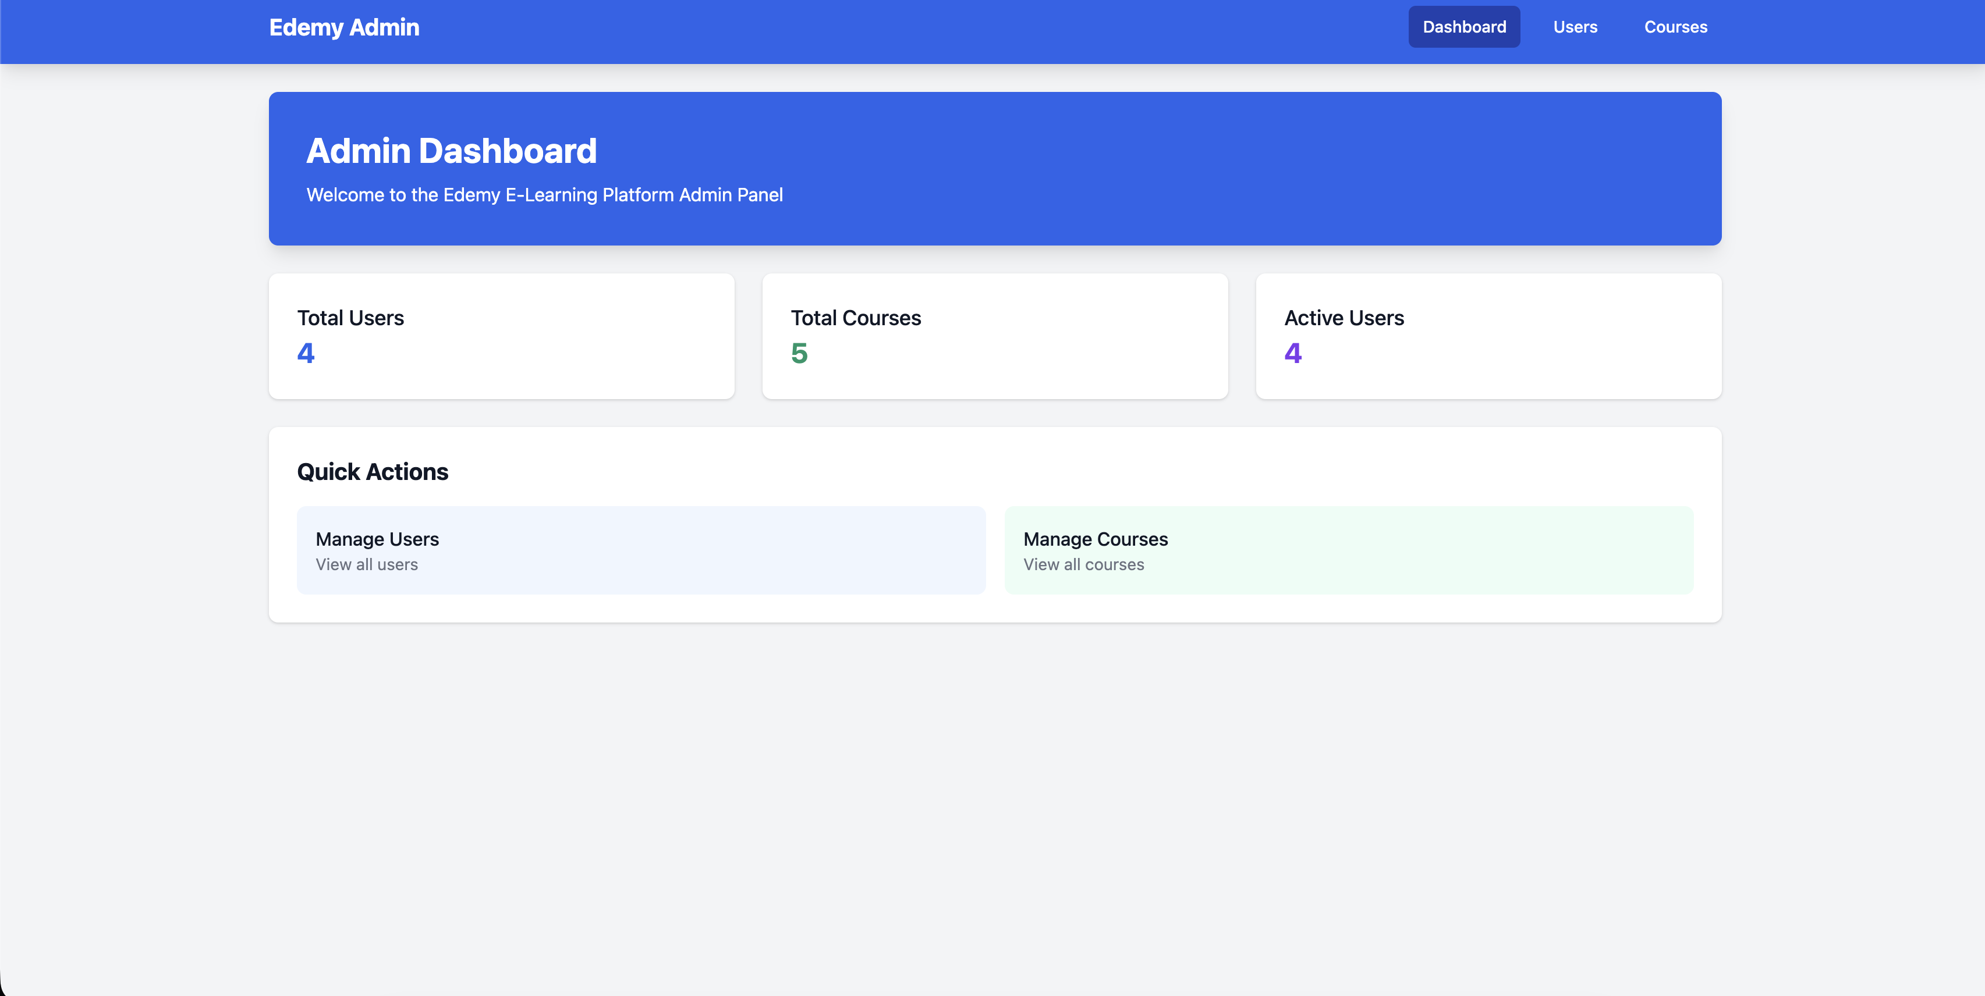
Output
Figure 7: Admin Dashboard

Slide 12
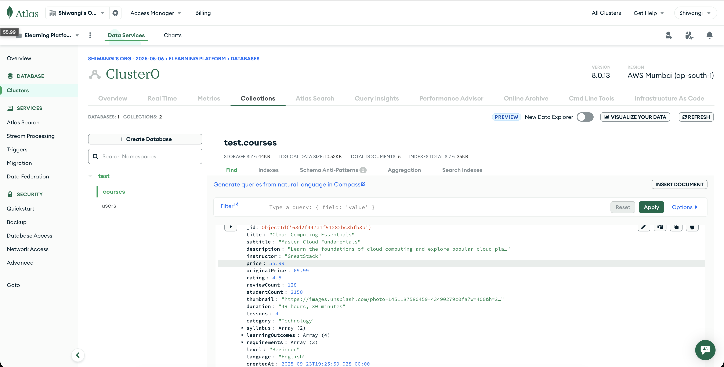
Output
Figure 8: Database storage

Slide 13
Project Github Link
Link: https://github.com/Shiwangikhanna349/Backend_PID2

